Slide 1
Software Project Management (SPM)
Lecture 1

Slide 2
Course Catalogue
This course covers fundamental concepts of software project management. Topics include:
  Software Project Management
  Managing Project Goals, Time & Costs
  Risk Management; Quality Management
  HR & Communication Management
  Software Project Pricing
  Software Development Management
  Development & Management Standards

Slide 3
Course Objective
To learn the techniques required to plan, organize, monitor and control software development projects.

Slide 4



Software

Slide 5
Software
Software can be considered a product of engineering just like an airplane, automobile, television, or an other object that requires a high degree of skill to turn a raw material into a usable product.
But software is developed or manufactured!
Software can be of different types:
  System software
  Application software etc.
engineered, not

Slide 6

Project

Slide 7
Project
Project
  It is a temporary endeavor (having specific start and completion dates) undertaken to create a unique product or service.
Temporary
It means that every project has a definite beginning and definite end
  End is reached when project’s objectives have been achieved OR it is clear that objective will not be met. The project is terminated in such a situation.
Unique
  It means that the product or service is different in some distinguishing way from all similar products or services.

Slide 8


Management

Slide 9
Management
The organization and
coordination
of the
activities of an
and in
enterprise in accordance with
achievement of defined objectives.
certain
policies
Management is the process of designing and maintaining an environment in which different individuals working together in the form of groups effectively and efficiently accomplished the desired objectives.

Slide 10


Why we need Management
To increase the productivity
To avoid time lapse
To organize task in daily life
To avoid wastage of resources

Slide 11
Responsibilities of Management
Answerable to Stakeholders of an organization
Give Employees good working conditions
Give customers right thing in right price & time
Maintain good relationships between organization and the suppliers
Develop future plans of the organization
Develop and ensure community support
Know-how of government rules and regulations
Awareness of currency fluctuation and interest rates
Preparation against disasters
Capability to manage the change

Slide 12
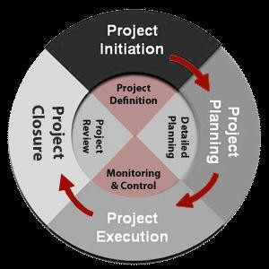
Management Activities
The management involves the following activities:
Planning- deciding what is to be done
Organizing- making arrangements
Staffing- selecting the right people for the job
Directing- giving instructions
Monitoring- checking on progress
Controlling- taking action to remedy hold-ups
Innovating- coming up with new solutions
Representing- liaising with users, etc.

Slide 13


Project Management
It is the discipline of planning, organizing, and managing resources to bring about the successful completion of specific project goals and objectives.
Project Management is the art of maximizing the probability that a project delivers its goals
  on Time
  within Budget
  at the required Quality.

Slide 14


Project Management
Project management is the application of
  Knowledge
  Skills
  Tools
  Techniques
to project activities to meet project requirements.
The more you know about your project, the better you are able to manage it.

Slide 15

Project Management
Following are related to Project Management
  Professional Organizations
    Project Management Institute (PMI) (pmi.org)
    Software Engineering Institute (SEI)
    IEEE Software Engineering Group
  Certifications
    PMI’s PMP (Project Management Professional)
    CAPM (Certified Associate in Project Management)
  The “PMBOK” – PMI Body of Knowledge

Slide 16
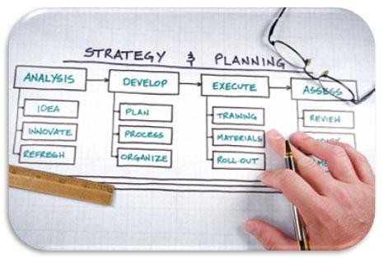

Project Management Skills
Leadership
Communications
Problem Solving
Negotiating
Influencing the Organization
Mentoring
Process and technical expertise

Slide 17

PMBOK
Project Management Process Groups
Project Management Knowledge Areas

Slide 18
Project Management Body of Knowledge[5]
The Project Management Body of Knowledge (PMBOK) is a collection of processes and knowledge areas generally accepted as best practice within the project management discipline.
Generally accepted means that it is applicable to most of the projects most of the time.
The Third Edition (2004) was recognized as a standard by the Institute of Electrical and Electronics Engineers IEEE 1490-2003.
The Fourth Edition (2008) was recognized by the American National Standards Institute (ANSI) as an American National Standard (ANSI/PMI 99- 001-2008).

Slide 19
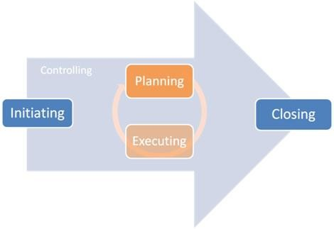
Project Management Process Groups [3]
PMBOK recognizes 5 basic process groups listed below.
  Initiating
  Planning
  Executing
  Monitoring and Controlling
  Closing

Slide 20
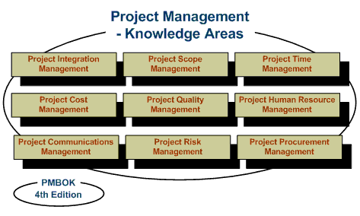
Project Management Knowledge Areas [3]
PMI has suggested 9 Knowledge Areas
  Project Integration Management
  Project Scope Management
  Project Time Management
  Project Cost Management
  Project Quality Management
  Project Human Resource Management
  Project Communications Management
  Project Risk Management
  Project Procurement Management

Slide 21

Software Project Management

Slide 22

Software Project Management
A sub-discipline of project management in which software projects are planned, monitored and controlled.
Software development is a complex undertaking particularly involves many people working over a relatively long time.
Hence software development projects need to be managed.
when it
Management
Project Management
Software Project Management

Slide 23
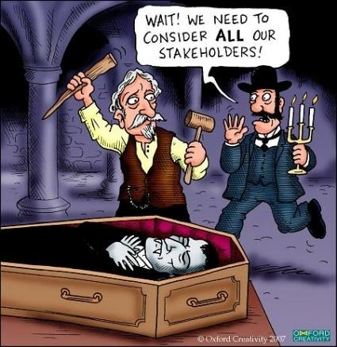
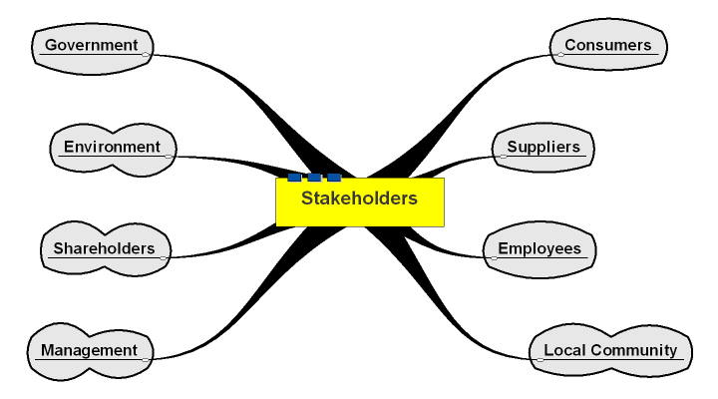
Interaction/Stakeholders [4]
As a PM, who do you interact with?
Project Stakeholders
  Project sponsor
  Executives
  Team
  Customers
  Functional managers etc

Slide 24
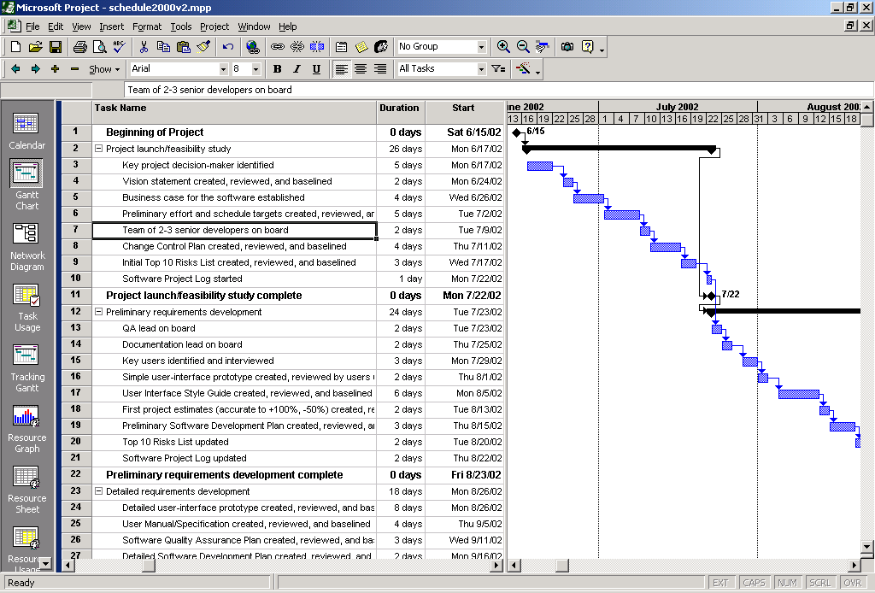
Project Management Tools

Slide 25
PM Tools: Software
Low-end
  Basic features, tasks management, charting
  MS Excel, Milestones Simplicity
Mid-market
  Handle larger projects, multiple projects, analysis tools
  MS Project (approx. 50% of market)
High-end
  Very large projects, specialized needs, enterprise
  Primavera Project Manager

Slide 26
References
Software Engineering: A Practitioner’s Approach – Roger Pressman
Software Engineering Project Management – Richard H. Thayer
PMBOK Guide 4rth Edition
http://en.wikipedia.org/wiki/Project_stakeholder
http://en.wikipedia.org/wiki/A_Guide_to_the_Project_Management_Body_of Knowledge

Slide 27


